Slide 1
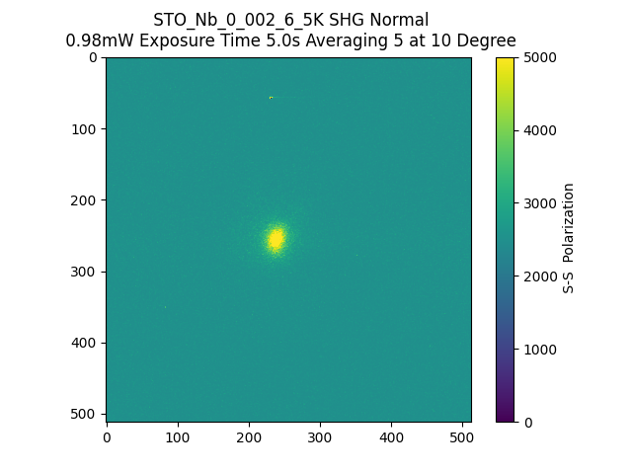
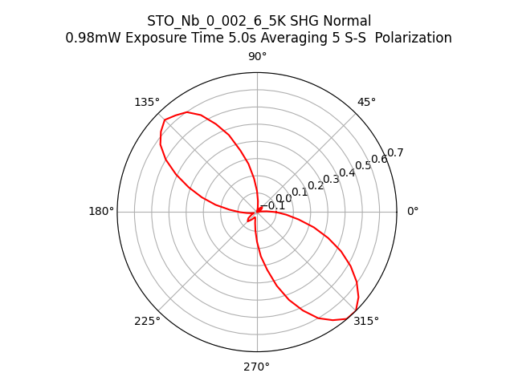
192504_STO_Nb_0_002_6_5K_SHG_Normal_SS

